Slide 1
Lecture 15: Conversion of DFA to RE(Arden's Method )
Agenda:
Arden's Method of Conversion of RE to DFA
Expression of Arden’s
Proof of Arden's Method
Examples
Presented by
Prof. Vaibhav Narayan Chunekar
K. J. Somaiya College of Engineering, Vidyavihar, Mumbai

Slide 2
Method of Conversion of DFA to RE
There are two methods to convert FA to regular expression –
DFA to RE
State Elimination Method / Iterative Method
Arden’s Theorem

Slide 3
Arden's Theorem
It states that-
Let P and Q be two regular expressions over ∑.
If P does not contain a null string ∈, then-
R = Q + RP has a unique solution
i.e. R = QP*

Slide 4
Importance of Arden's Theorem
The Arden's Theorem is useful for checking the equivalence of two regular expressions.
Arden's Theorem can be also be used to find a regular expression for both DFA and NFA.

Slide 5
Arden's Theorem Conditions
To use Arden’s Theorem, following conditions must be satisfied-
The transition diagram must not have any ∈ transitions.
There must be only a single initial state.

Slide 6
Arden's Theorem Steps
To convert a given DFA to its regular expression using Arden’s Theorem, following steps are followed:
Step-01:
Form a equation for each state considering the transitions which comes towards that state.
Add ‘∈’ in the equation of initial state.
Step-02:
Bring final state in the form R = Q + RP to get the required regular expression.

Slide 7
Arden's Theorem on Multiple Final States
If there exists multiple final states, then-
Write a regular expression for each final state separately.
Add all the regular expressions to get the final regular expression.

Slide 8
Arden’s Theorem Proof:
How to prove ?
R = Q + RP has a unique solution i.e. R = QP*
1ST Part: R = Q + RP then R = QP*
➔R=Q+RP--------------------→ equation 1
Replace R with QP*
➔R=Q+QP*. P
➔R=Q(ε+P*.P)-------------------→ ε+R*.R=R* →identities of RE
➔R=Q.P*

Slide 9
Arden’s Theorem Proof:
2ND Part: R = Q + RP then R = QP* provide UNIQUE solution
➔
R= Q+RP
R=Q+(Q+RP)P ➔ Replace Q+RP
R=Q+QP+RP²
.
.
R=Q+QP+.........+QP ^{n} +RP ^{n+1} ➔Replace R = QP*
R=Q+ QP+........+ QP ^{n} + QP* P ^{n+1} ➔Take Q Common
R=Q [ε+ P+P² + ......... P ^{n} + P* P ^{n+1} ] ➔ Closure Property of P
R=QP*
Hence we proved Arden’s Theorem has unique Solution R = QP* over equation R = Q + RP .

Slide 10
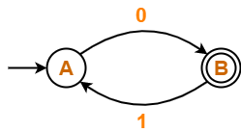
Problem 1: Find regular expression for the following DFA using Arden’s Theorem-

Slide 11
Step-01:
Form a equation for each state-
A = ∈ + B.1 ……(1)
B = A.0 ……(2)

Slide 12
Step-02:
Bring final state in the form R = Q + RP.
➔ Using (1) in (2), we get-
B = (∈ + B.1).0
B = ∈.0 + B.1.0
B = 0 + B.(1.0) ……(3)

Slide 13
Apply Ardens Theorem R = Q + RP then R = QP*
B = 0 + B.(1.0)
➔ B = 0.(1.0)*
Thus, Regular Expression for the given DFA = 0(10)*

Slide 14
Example 2: Find regular expression for the following DFA using Arden’s Theorem-
Solution-
Step-01:
Form a equation for each state-
q1 = ∈ ……(1)
q2 = q1.a ……(2)
q3 = q1.b + q2.a + q3.a …….(3)

Slide 15
Step-02:
Bring final state in the form R = Q + RP.
Using (1) in (2), we get-
q2 = ∈.a
q2 = a …….(4)
Using (1) and (4) in (3), we get-
q3 = q1.b + q2.a + q3.a
q3 = ∈.b + a.a + q3.a
q3 = (b + a.a) + q3.a …….(5)

Slide 16
Apply Ardens Theorem R = Q + RP then R = QP*
Using Arden’s Theorem in q3 = (b + a.a) + q3.a ,
we get-
q3 = (b + a.a)a*
Thus, Regular Expression for the given DFA = (b + aa)a*

Slide 17
Thanks !!!
Any Query???

Slide 18
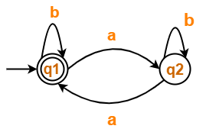
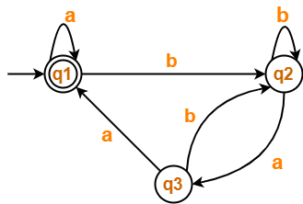
Home Assignment: Convert following DFA into RE:

